Slide 1

PSORIASIS
DR. AYA YOUSEF BADRAN
Notes:
NOTE:
To change the image on this slide, select the picture and delete it. Then click the Pictures icon in the placeholder to insert your own image.

Slide 2
PSORIASIS
Definition:
It is a common , chronic, recurrent, inflammatory disease of the skin characterized by: well-defined, red, scaly lesions of various sizes, covered with silvery white scales.

Slide 3
Aetiology:
Provocative Factors:
Genetic predisposition.
Immunological abnormalities.
Trauma.
Infection.
Weather.
Stress.
Drugs: antimalarials, B-adrenergic blockers

Slide 4
Clinical types :
Psoriasis vulgaris. (80-90%)
Guttate Psoriasis.
Discoid (Coin-shaped)
Annular (Ring shaped)
Scalp psoriasis.
Nail psoriasis
Flexural psoriasis.
Pustular Ps. (severe)
Erythrodermic Ps. (severe)
Arthropathic Ps. (severe)

Slide 5
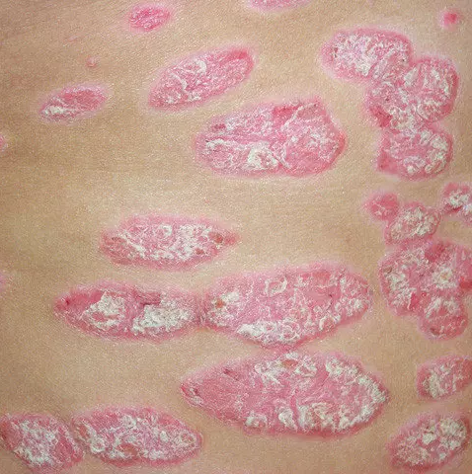
Clinical picture (classical) (vulgaris)
Lesion: erythematous papules and plaques covered by silvery white scales.
Usually bilateral and symmetrical.
Site: any site can be affected.
(commonly extensor surfaces of the limbs, elbows, knees)

Slide 6
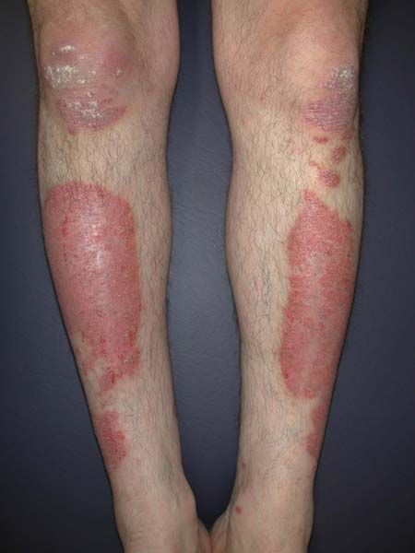
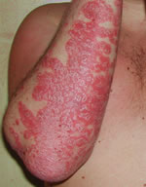
Psoriasis vulgaris

Slide 7

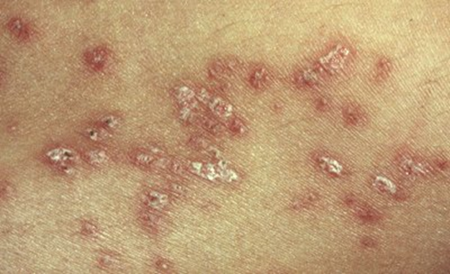
Guttate Psoriasis

Slide 8
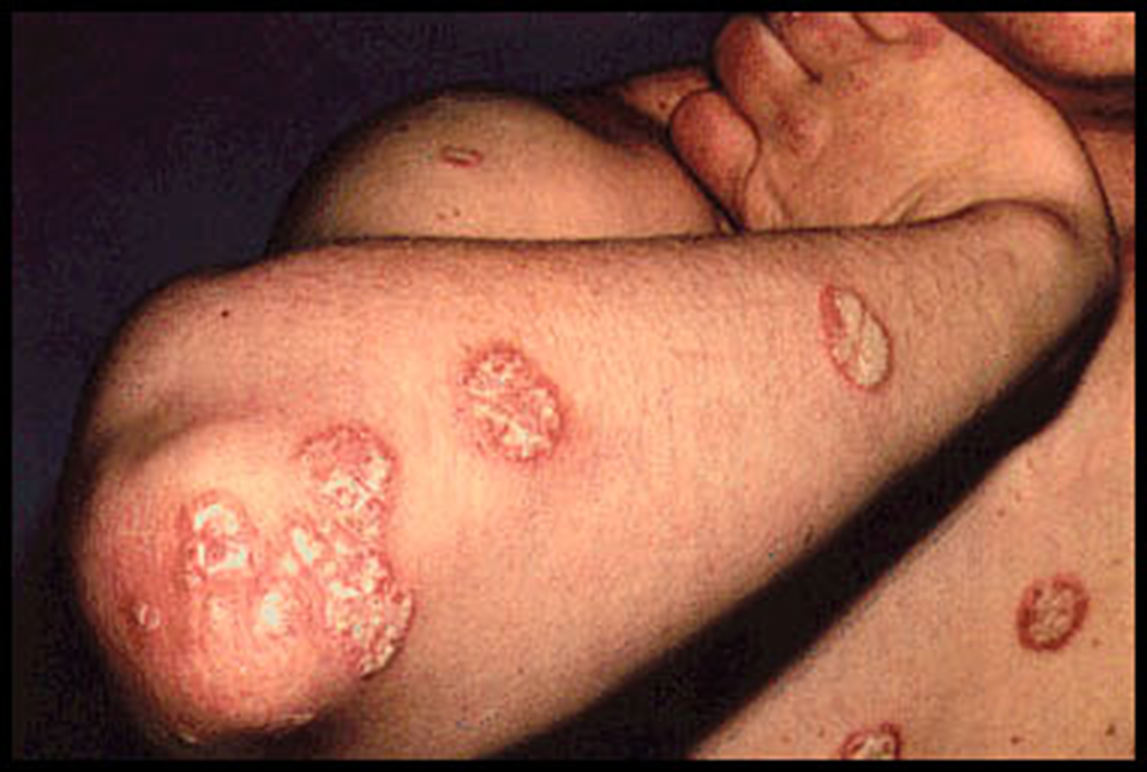
Discoid Psoriasis

Slide 9
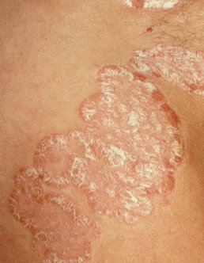
Annular Psoriasis

Slide 10
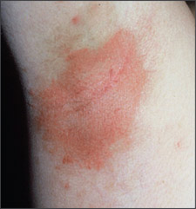
Flexural Psoriasis

Slide 11
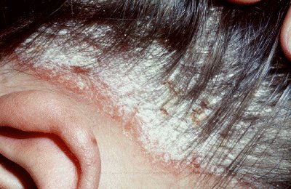
Psoriasis of the Scalp

Slide 12
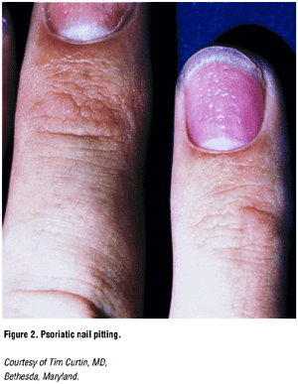
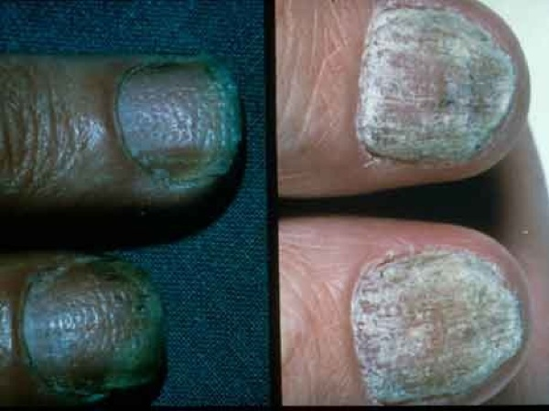

Slide 13
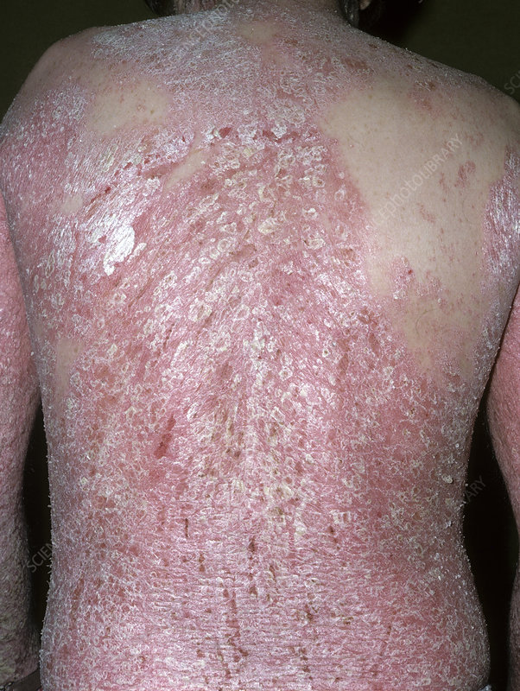
Erythrodermic Psoriasis

Slide 14
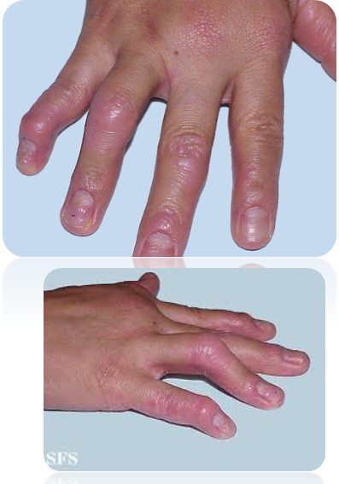
Arthropathic Psoriasis

Slide 15
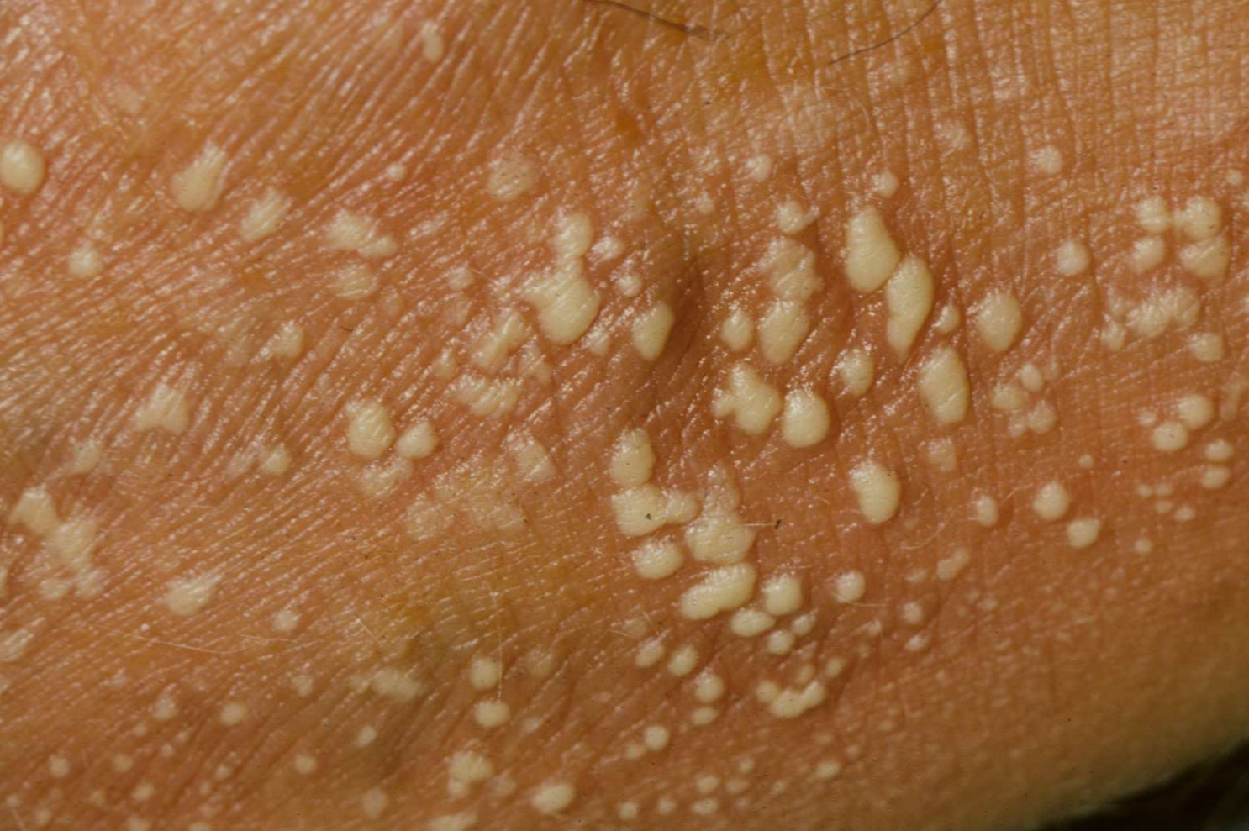
Pustular Psoriasis

Slide 16
PSORIASIS
Auspitz sign:
scraping→scales →bleeding points(dilated capillaries).
Koebner’s phenomenon:
It is the appearance of typical lesions at sites of injuries.

Slide 17
PSORIASIS
Management :
Reassurance and Explanation :
Psoriasis is a chronic disease that cause psychological
stresses
1- It is not infectious
2- It is of benign nature
3- Spontaneous remission can occur
4- Therapy is available

Slide 18
Treatment:
A-Topical therapy
Corticosteroids (most frequent).
Crude coal tar 2-5%.
Dithranol.
Salicylic acid 3-5%.
Vitamin D3 analogue, inhibit keratinocyte proliferation (Calcipotriol).
Ultraviolet light: antimitotic effect
B- Intralesional Steroids

Slide 19
Treatment:
C- Systemic therapy
Only in severe forms of psoriasis
(erythrodermic, arthropathic, pustular)
Methotrexate.
Retinoids.
Cyclosporine A.
PUVA. It involves the use of a psoralen (P) followed by exposure to long wave ultraviolet light (UVA).
Biologic therapy
Corticosteroids (it is contraindicated in psoriasis vulgaris).

Slide 20



